Slide 1



UNIT 2
Lesson 7
IN SYNC WITH YOUR PARENTS
Part 2

Slide 2
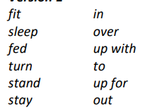
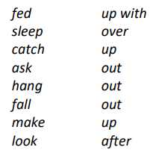
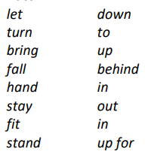
fit
sleep
fed
turn
stand
stay
out
in
over
up for
to
up with
let
turn
bring
fall
hand
stay
fit
stand
up for
down
to
in
up
out
behind
in
fed
sleep
catch
ask
hang
fall
make
look
out
after
up with
up
over
out
out
up

Slide 3
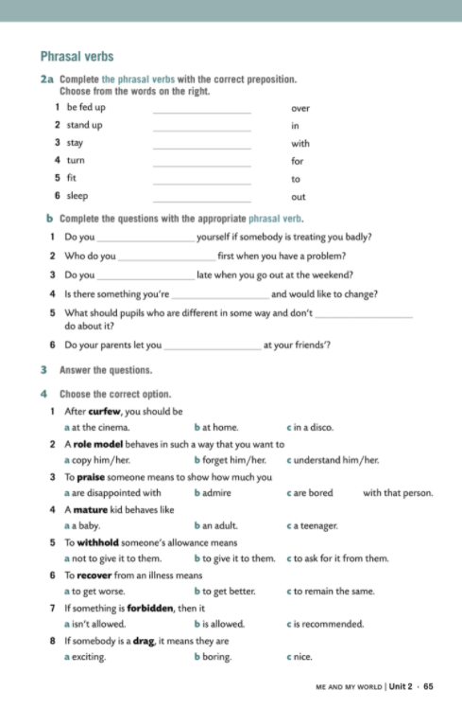
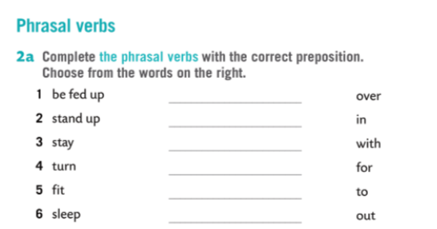
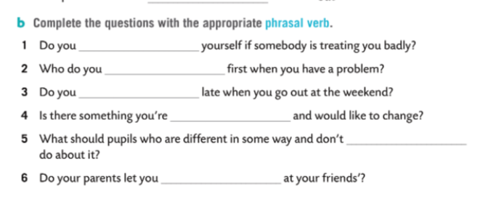
with
for
out
to
in
over
stand up for
turn to
stay out
fed up with
fit in
sleep over

Slide 4
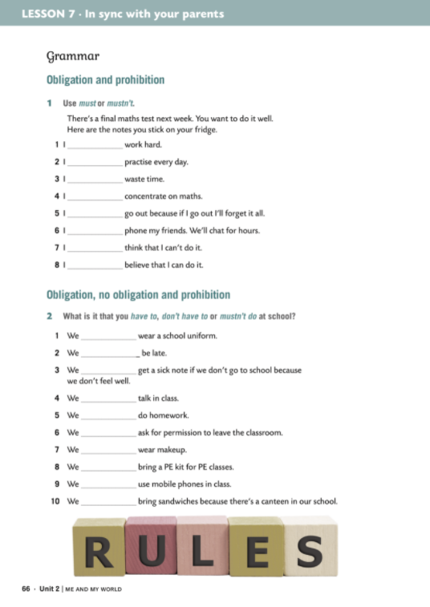
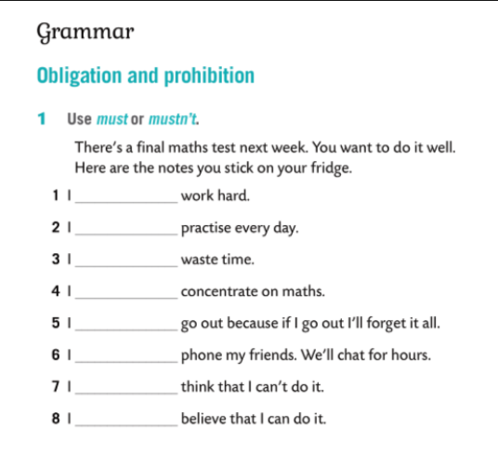
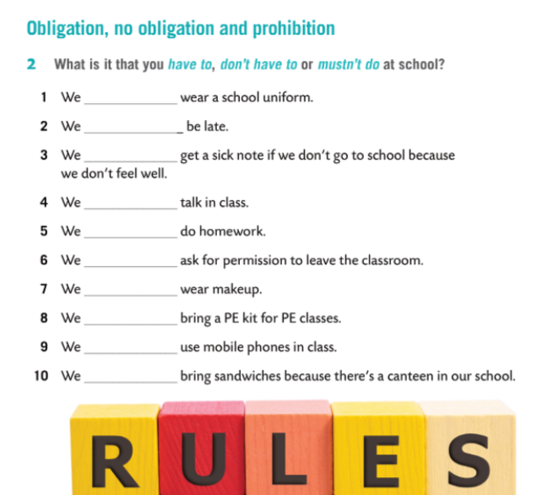
don’t have to
must
mustn’t
must
have to
mustn’t
must
mustn’t
mustn’t
have to
mustn’t
have to
mustn’t
mustn’t
must
have to
mustn’t
don’t have to

Slide 5
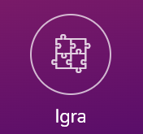
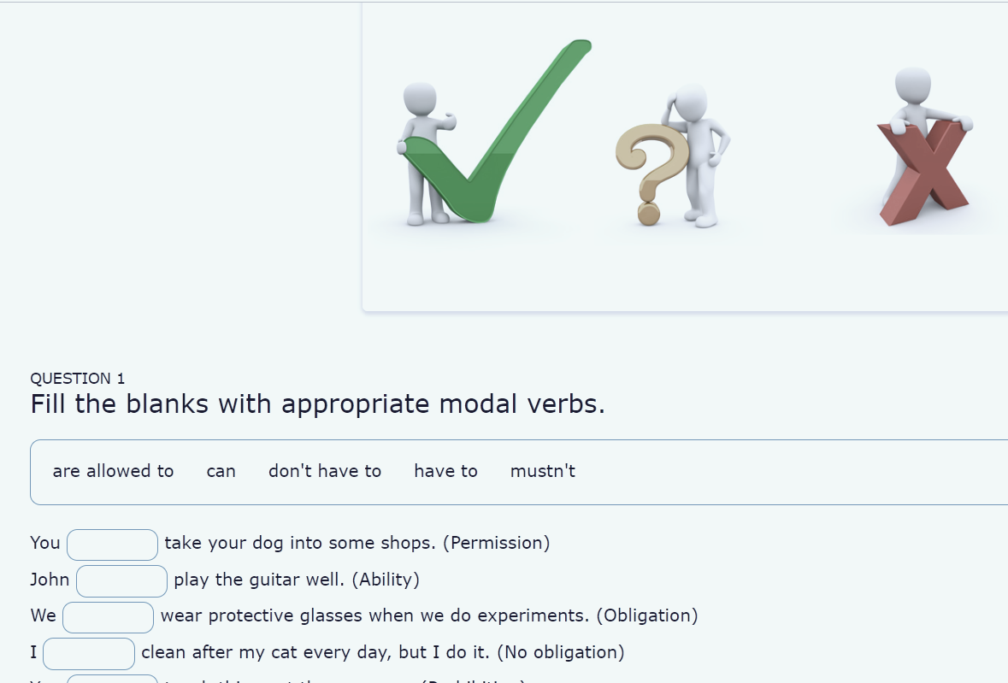
MODAL VERBS
VOCABULARY

